Slide 1
Age-Friendly Health Systems:
Evidence-Based Care for All Older Adults
Age-Friendly System-Wide Spread Collaborative
Learning Session #1
April
IHI.org/AgeFriendly
Notes:
Leslie

Slide 2
Agenda
3:00 pm ET​ | Welcome ​and introductions
3:05 pm ET​ | Collaborative Overview
3:15 pm ET​ | Pre-work
3:35 pm ET​ | Learning Session #1 and Wrap-up
3:40 pm ET​ | Q&A
Notes:
Leslie

Slide 3
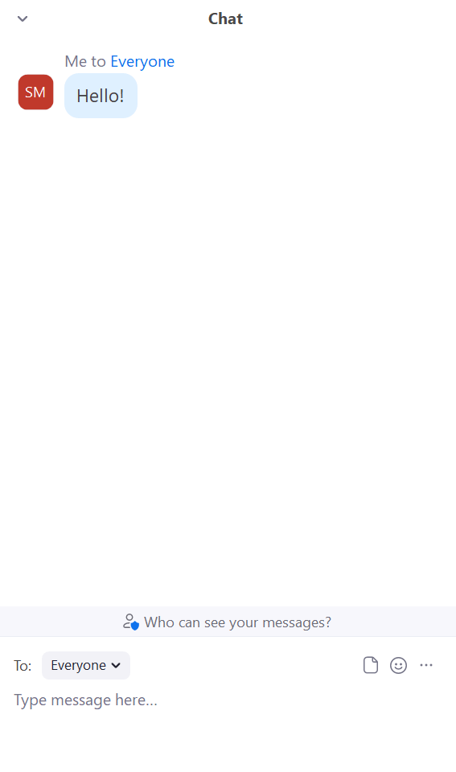
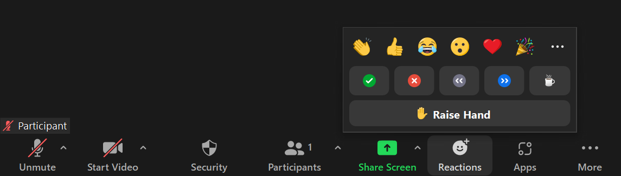
Participating in Today’s Discussion
Using the Chat
Introduce yourself
Ask questions
Select “Everyone” from the dropdown menu before sending in your questions and comments
Using the Reactions Button
Click on "Reactions" at the bottom of the screen
Raise your hand if you would like to speak up
Notes:
Leslie
Use the chat to ask questions
We will address them in the final 20 minutes of the call

Slide 4

Welcome and Introductions
Please chat in:
Your name and role
Organization name
State
Notes:
Leslie

Slide 5

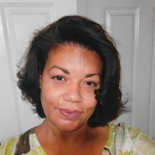



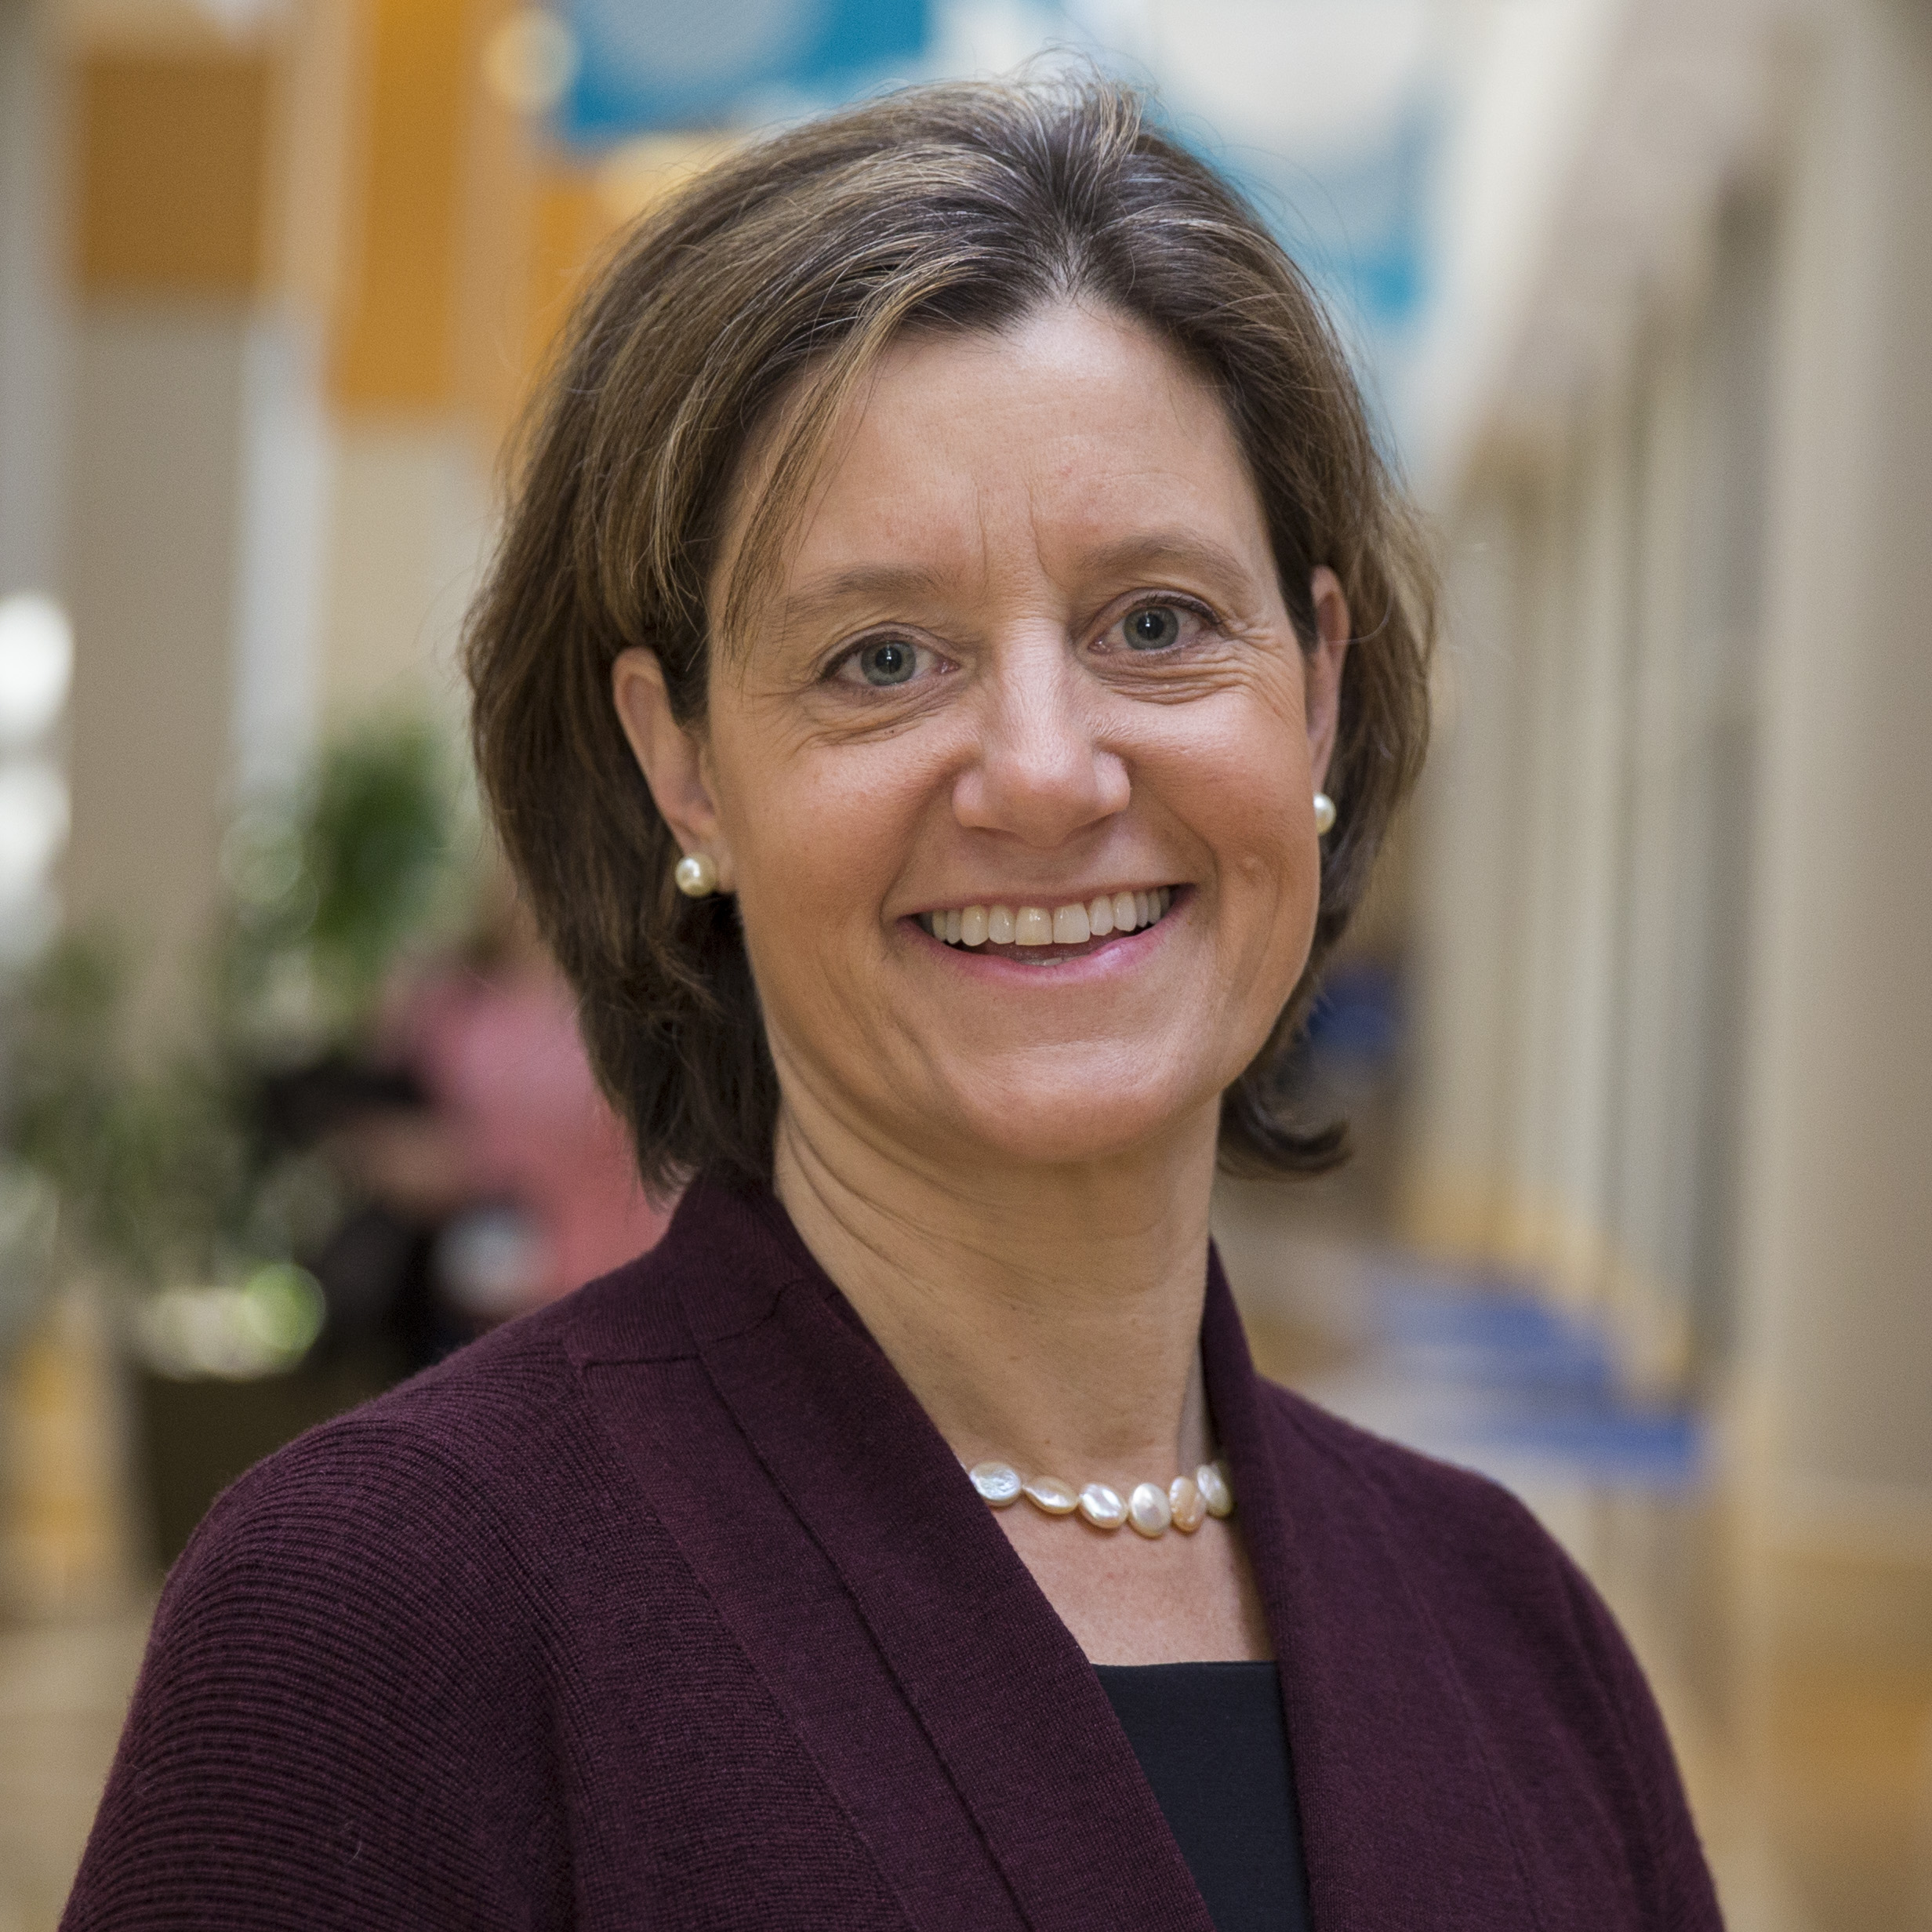
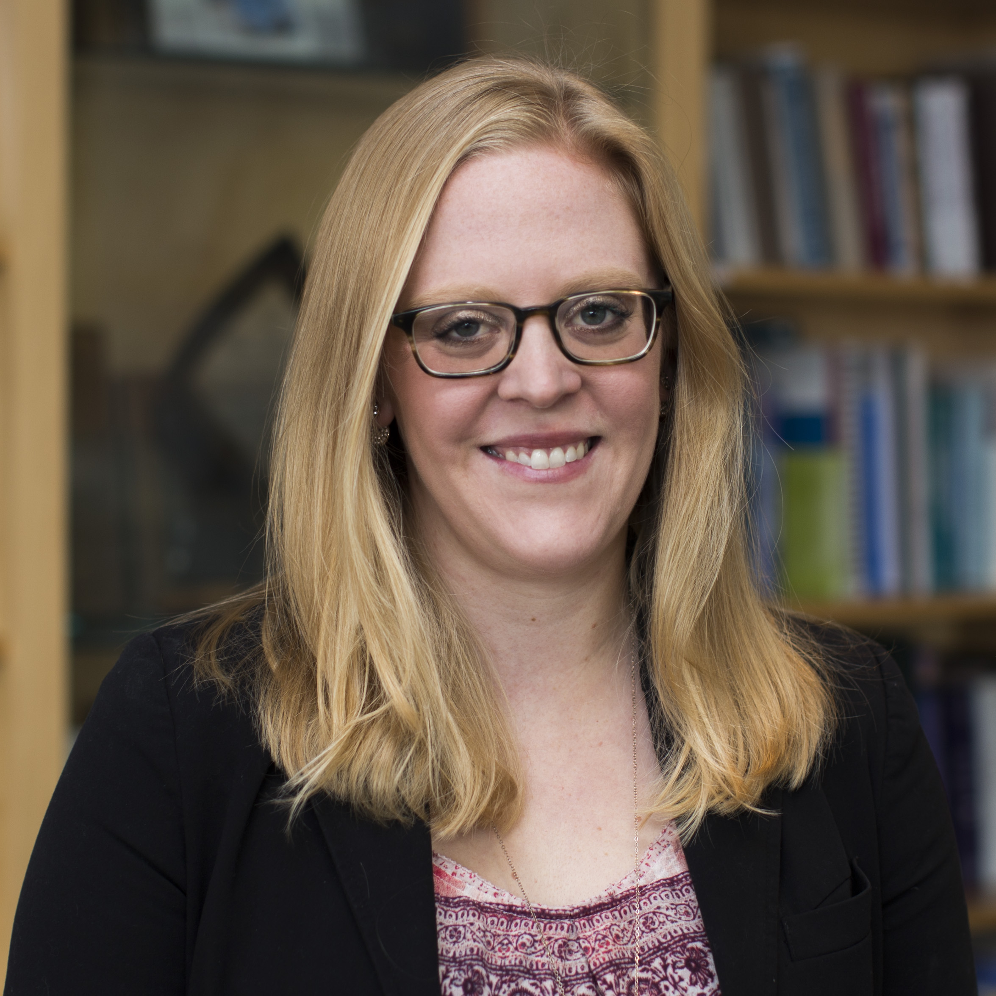
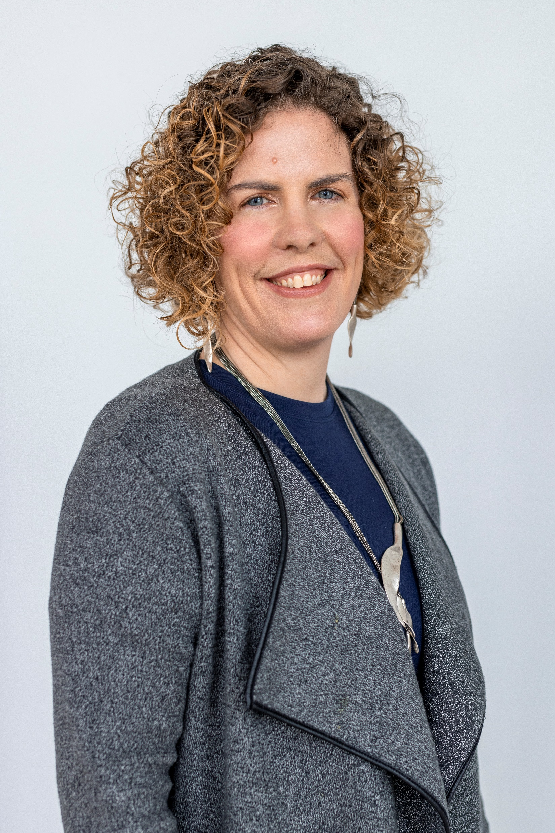
System-wide Spread Team
Dawn Johnson, MSN, RN
Equity Faculty Expert
Laurita Kaigler-Crawlle, MS
Project Director
Kedar Mate, MD
President and CEO
Anika Mayar,
Project Assistant, Co-Op
Amanda Meier, MA
Project Manager
Leslie Pelton, MPA
Vice President
KellyAnne Pepin, MPH
Senior Project Director
Christina Southey, MSc
Improvement Advisor
Notes:
Leslie
More faculty TBA
Introduce Cheryl

Slide 6
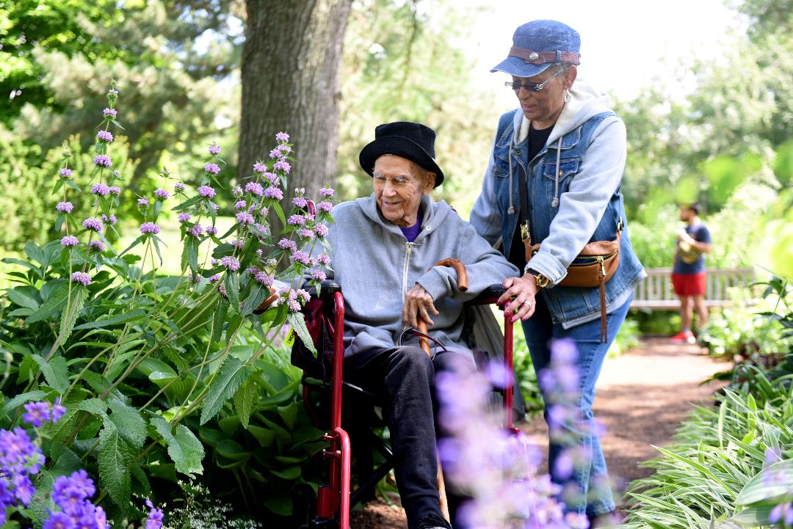
Our Mission
Build a movement so all care with older adults is age-friendly care:
Guided by an essential set of evidence-based practices (4Ms);
Causes no harms; and
Is consistent with What Matters to the older adult and their family.
Notes:
Leslie-introduce Cheryl

Slide 7
Mission
DEDICATED TO IMPROVING THE CARE OF OLDER ADULTS
Age-Friendly
Health
Systems
PRIORITY AREAS
Family
Caregiving
Serious Illness &
End of Life
Notes:
A catalyst for change. Collaboration is in our DNA. All efforts with a lens to improve disparities
Cheryl Phillips

Slide 8
The Age-Friendly System-Wide Spread Collaborative
Notes:
Laurita

Slide 9
Don't forget to make your travel arrangements!
The hotel block expires on 4/5
Notes:
Laurita—Harborside Inn

Slide 10
Collaborative Aim Statement
75% of facilities that serve older adults will be recognized by IHI as Committed to Care Excellence
and
60% of all older adults served in the IHI recognized facilities will receive care aligned with the 4Ms framework
By October 2025
Notes:
Laurita-read slide

Slide 11
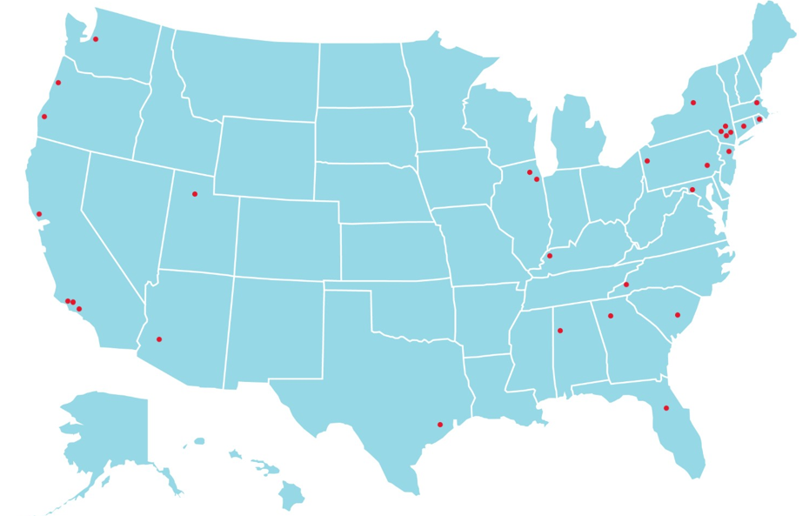
AdventHealth Hendersonville
Advocate Health
Banner Health
Bassett Health
Cedars Sinai
CommonSpirit
CVS MinuteClinic
Grady Health
Greater Los Angeles VA
Hackensack Meridian Health
Hartford HealthCare
Hebrew Senior Life
Jefferson Health PA
Luminis Health
MediSys Health Network
Mount Sinai Health System
Northwell Health
Oregon Health Sciences University
Orlando VA
Owensboro Health
Presbyterian Senior Care Network
Providence
Ralph H. Johnson VA Health Care System
Roseburg VA
St. John's Hospital New York
Sutter Health
UC Irvine
University of Alabama at Birmingham
University of Utah
UT Health
30 Age-Friendly Health Systems are participating in the Age-Friendly System-Wide Spread Collaborative
​
Notes:
Laurita-
All 30 participating health systems have committed to embedding the 4 Ms framework to care delivery for older adults receiving care in your health systems
We’ll have the opportunity to get to know one another over the next 18 months, beginning in person in a few short weeks. But it evident in the slide the diverse and rich and range of care settings from in patient, hospital settings to ambulatory, primary care, convenient care as well as nursing home settings. We have federally qualified health centers Academic Medical Centers Safety Net Hospitals and critical access hospitals providing care to exceptionally diverse patient panels.

Slide 12
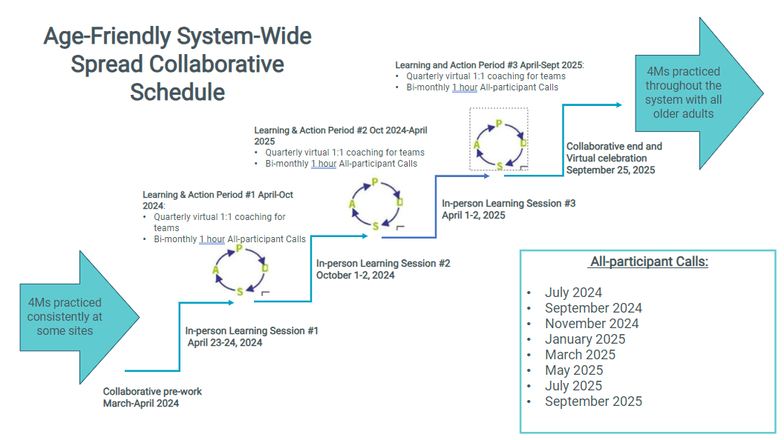
Notes:
Laurita
The structure for our collaborative includes 3 in person learning sessions beginning on April 23 and 24th of this month, followed by LS2 on October 1st and 2nd with our final LS on April 1 and 2 next year 2025.
Occurring between the learning sessions are the Action periods. The first between April and October 2024. This Action periods will include scheduled coaching calls with IHI faculty as well 1 hour, topical all team calls scheduled bi monthly, beginning in July.
The Collab end and virtual celebration will occur 9/25/25

Slide 13
Collaborative Selection Process and Timeline
Dec 2023
Invitation, prospectus, and application sent to eligible health systems
02 Feb. 2024
Applications and leadership support letter due
Mar. 2024
Systems notified of decision
23-24 Apr. 2024
Learning Session
In-person in Boston
1.5 days
Mar. 2024
Prework
Receive change
package, measurement
strategy, and self-assessments
Notes:
Laurita
We are ready to launch-This April, following today’s kick off call,we will come together in Boston, in person on 4/23 and 4/24 for our first learning session.

Slide 14
Learning Sessions
Three two-day in person Learning Sessions
Locations of Learning Sessions 2 and 3 are to-be-decided
Learning and networking with peers
Discover change ideas to test and adapt to your health system
Storyboards from each team to highlight results and work to date
1-2 team members attend in-person Learning Sessions
Register via Zoom for the meeting series
Notes:
Laurita- read slide

Slide 15
All-Participant Webinars
Virtual, connection-based sessions
Focused on topics relevant to system-wide spread of the 4Ms
Share learning, problem solving, and uncover innovative solutions
Refine your spread strategy to reach the Collaborative Aim
Webinars are led by IHI faculty subject-matter experts
Notes:
Laurita 7 calls focus on content and change ideas from the driver diagram.

Slide 16
All-Participant Webinar Topics
Subject Matter Expert faculty dig into the primary drivers of Spread of the 4Ms:
  Optimizing organizational goals aligned with leadership
  Developing out System Capabilities, to deliver the 4Ms
  Supporting your Care team capabilities to deliver 4Ms care,
  Effective measurement of the 4Ms for targeted impact.
  Addressing gaps related to equity in the experience of the 4Ms
Notes:
Laurita
July 2024 - Leadership Call
Aligning system priorities and Age Friendly 4Ms quality improvement efforts.
Description: This call will focus on aligning the organizational priorities with Age Friendly initiatives, emphasizing quality improvement efforts aimed at enhancing the care for older adults. Topics will include strategic planning, resource allocation, and fostering a culture of innovation to support Age Friendly practices.
September 2024 - Health System Capabilities
Maximizing Your Health Systems' Electronic Health Record (EHR) platform to support 4Ms framework quality improvement practices.
Description: This session will delve into leveraging electronic health record platforms to effectively implement and integrate the 4Ms framework into clinical workflows. Participants will learn strategies for optimizing EHR functionalities to enhance patient-centered care for older adults.
November 2024 - Staff Capabilities
Identifying and optimizing training and education strategies to advance spread of the 4Ms system-wide in targeted settings for all Providers and support staff.
Description: This call will explore effective training and education strategies to disseminate the principles of the 4Ms framework among healthcare providers and support staff across various care settings. Topics will include competency-based training, role-specific education, and fostering interdisciplinary collaboration.
January 2025 - Measurement Strategies
Measurement strategies that enable identification of inequities via analysis of outcomes stratified by age, race, ethnicity, and ideally gender identity.
Description: Participants will learn about measurement strategies to identify and address disparities in healthcare outcomes among older adults. This session will focus on collecting and analyzing data stratified by demographic variables to ensure equitable care delivery.
March 2025 - Equitable Practice of the 4Ms
How to measure the impact of Age Friendly care for older adults at the local and national scale.
Description: This session will discuss methods for evaluating the impact of Age Friendly practices on older adults at both local and national levels. Participants will explore outcome measures, benchmarks, and tools for assessing the effectiveness of Age Friendly initiatives.
May 2025 - Organizational Impact
Identifying the broad organizational impact of reliable implementation of the 4Ms and tying the intrinsic value to organizational gains and return on investment.
Description: This call will focus on understanding the organizational impact of implementing the 4Ms framework effectively. Participants will learn how to assess the value proposition of Age Friendly practices, including their potential for improving patient outcomes, enhancing staff satisfaction, and achieving financial sustainability.
July 2025 - Geri-Ed Verification
All you need to know about Geri-Ed verification.
Description: This session will provide comprehensive information on Geriatric Emergency Department (Geri-ED) verification, including the criteria, process, and benefits. Participants will learn about the requirements for achieving Geri-ED verification status and its implications for enhancing emergency care for older adults.
September, 2025-Focus on Age-Friendly Pharmacy Policy and Practices
Strategies to address older adult medication needs through Age-Friendly pharmacy policy and practices.
Description: This call will explore strategies for optimizing pharmacy services to meet the unique medication needs of older adults. Topics will include medication reconciliation, deprescribing initiatives, pharmacist-led interventions, and promoting medication safety in Age Friendly healthcare settings.

Slide 17
Coaching Calls
IHI IA and faculty will provide coaching support to triads of health system teams
Conversations will be focused on sharing improvement ideas and discussing approaches on testing and implementation
Triads will allow peers to learn from each other in a smaller group environment
Sessions are bi-monthly and focused on what triads most want to prioritize
Begin in June
Notes:
Laurita

Slide 18
Pre-Work
Notes:
Laurita

Slide 19

Participant Packet
Sent to all teams via email on March 28th
Details Collaborative:
  Background,
  Approach
  Expectations
  Schedule and activities
  IHI staff and faculty experts
  Health system participants
  Included links to the Change Package, Measurement Strategy, and Collaborative Aim
Notes:
Laurita—introduce Dawn

Slide 20
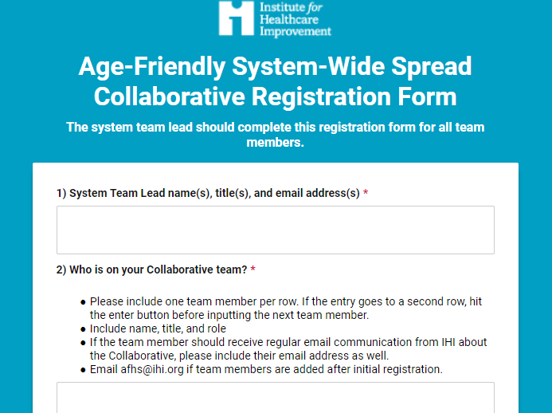
Team Enrollment Form
Meet with your team and enroll by April 10th
Complete one Team Enrollment Form on so we know who’s on your team and their contact information
Includes information for team members attending the in-person Learning Session.
Notes:
Dawn

Slide 21
Review Collaborative Documents and Tools
Documents provided via email and in the Participant Packet
Collaborative Aim
Measurement Strategy
Change Package
Notes:
Dawn

Slide 22
System Storyboards
Create and submit your systems introductory Storyboard by April 20th
  Use the PowerPoint template sent to you via email
Use pictures, data displays and any other visuals you find effective to communicate where you are and where you are going
Keep your storyboard to a maximum of 12 slides
Print and bring your storyboard Slides with you to the session
Storyboard slides will be displayed on physical boards (not projected)
Notes:
Dawn

Slide 23
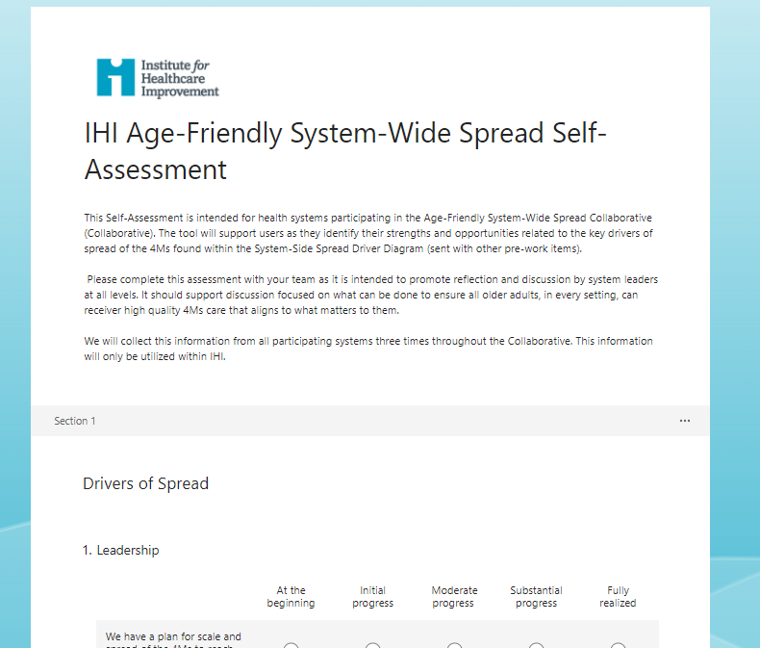
Self-Assessment
Complete the System Self-Assessment by April 20th
  Self-Assessment will be completed three times throughout the Collaborative
  Completed via Microsoft Form
  One submission per system
  Responses will help systems decide where to focus effort, and help IHI prioritize webinar content and direct focus for coaching calls
Notes:
Dawn—Pass to Christina

Slide 24
Add your publications to the Collaborative Bibliography
Add your system’s AFHS related publications to the Collaborative Bibliography by April 20
We want to know what published AFHS work your system is already doing!
Resource for participants to learn from peers
Bibliography can be updated throughout the Collaborative to reflect current publications
Notes:
Christina
March 28th Link to an editable excel spreadsheet.

Slide 25

Start (or continue!) Team Huddles
Regular connections of 4Ms spread team will be critical for success
If possible, consider shorter weekly touchpoints (huddles)
Discuss how you will formally announce your participation in the Collaborative with the rest of your organization
Consider what additional touchpoints are needed with the wider organization involved in 4Ms related activities
Notes:
Christina

Slide 26


Collaborative Communication Strategy
IHI communications department creating a press release template for systems
Ready in April
IHI will issue the first press release. Systems can then link back to this in their own releases
Begin to consider your internal communications strategy by using the IHI slide template sent via email
Notes:
Christina

Slide 27
Collaborative Measurement
Participating Health Systems track three aggregate metrics once/month for recognized sites
Measure definitions align with existing AFHS measures guide and 4Ms care description
Participating systems with existing dashboards can utilize data already collected and reported for quarterly outcome data
Systems asked to stratify data quarterly to explore equity in key collaborative metrics
Notes:
Christina

Slide 28
Learning Session #1 and Wrap-up
Notes:
Christina—pass to Laurita

Slide 29



What to bring to Learning Session One
Data
  See details in participant pre-work packet
Physical copy of System Storyboard slides
Remember to register for the All-Participant Call Series!
53 State Street
Notes:
Laurita—pass to KellyAnne for next slide

Slide 30

IHI Forum
Session Abstracts due: April 30, 2024
Posters due: November 1, 2024
Submit Here
The IHI Forum Team is looking for interactive, innovative session proposals!
Great dissemination opportunity: celebrate your progress and build interest in Age-Friendly Health Systems
World Center Marriott
Notes:
2024 IHI Forum; https://www.ihi.org/education/conferences/ihi-forum
KellyAnne

Slide 31

Join IHI’s 2024 Action Community!
31
7-month, virtual community
Monthly webinars about the 4Ms and resources to support implementation
Community of testers and learners
Bright spot examples of organizations sharing how they implement the 4Ms
Support your health organization’s mission, vision, and values
There is no fee to participate Visit ihi.org/agefriendly
Notes:
KellyAnne

Slide 32
Questions?
Notes:
KellyAnne
Take down slides for questions and discussion

